Slide 1

SciGRID_gas workshop Berlin January 2020 Jan C. Diettrich Institute of Networked Energy Systems Adam Pluta Jan Dasenbrock Wided Medjroubi

Slide 2
Tasks
Please start download of project from GitHub
git clone https://github.com/jdlr01/OpenSciGRID_gas.git
OR
Download from stick
Download all required libraries using on DOS/Unix prompt:
Unix pip install -r requirements.txt
Windows: pip install -r requirements_pip.txt conda install --file requirements_conda.txt

Slide 3
Overview
Institute
SciGRID_gas project introduction
SciGRID_gas definitions
SciGRID_gas OpenStreetMap
SciGRID_gas Non-OSM data
Heuristics
Hands on data set generation

Slide 4
Overview of the DLR-Institute of Networked Energy Systems

Slide 5

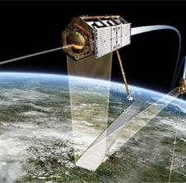



The German Aerospace Centre (DLR)
Credit: Nonwarit/Fotolia
Research institutes, aerospace-agency, project manager
Flight, aerospace, energy, transport, digitalisation and security
~8.000 employees in 40 institutes/facilities in 20 locations; Offices in Brussel, Paris, Tokyo und Washington
Turnover 2017: 922 Mio. €
Member of the Helmholtz-Gemeinschaft

Slide 6
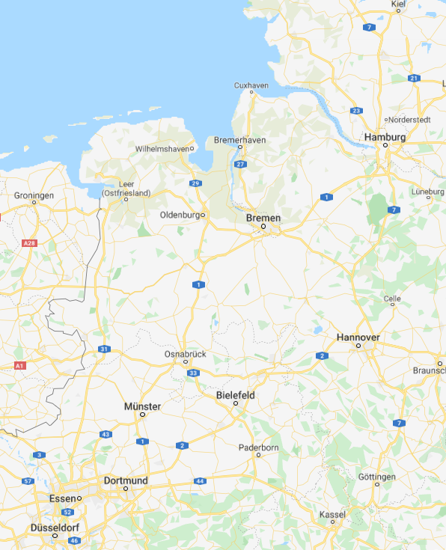
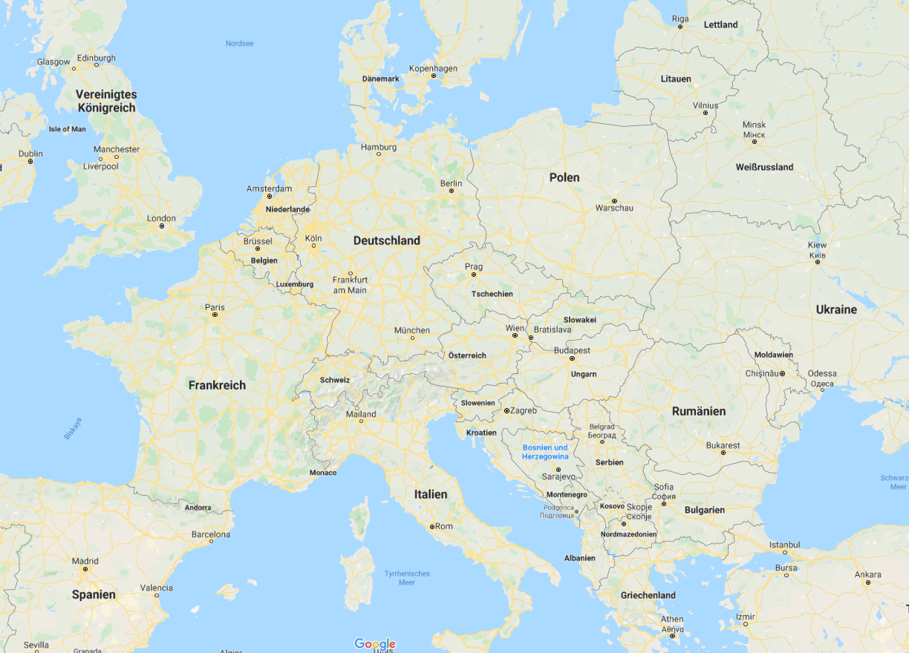

Institute of Networked Energy Systems:

Slide 7
Institute of Networked Energy Systems: Structure
City- and building- technologies
Energy system technologies
Energy system- analysis
Energy- meteorology
Energy system -modelling
Energy scenario & technology- rating
Network- technology
Flexibility and system- application
Energy- management
Sector-coupling mobility
Sector-coupling gas technic
Sector-coupling buildings

Slide 8
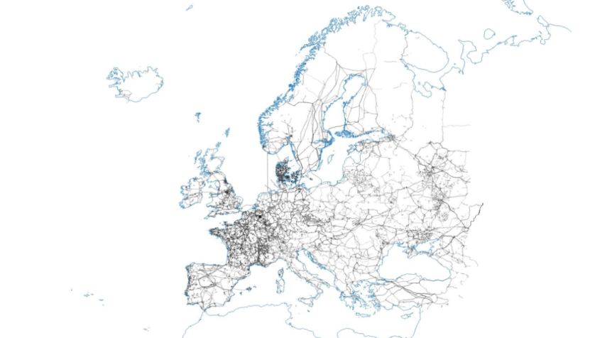
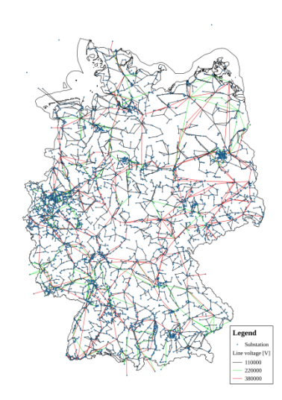
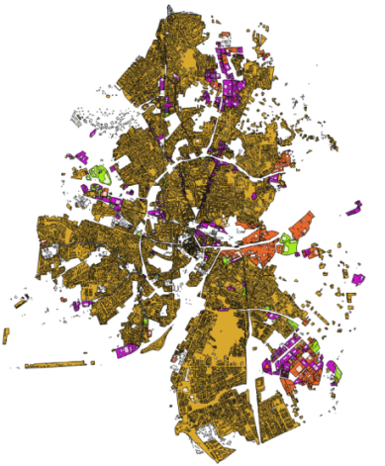
Research focus
Transnational
National
Regional and urban

Slide 9
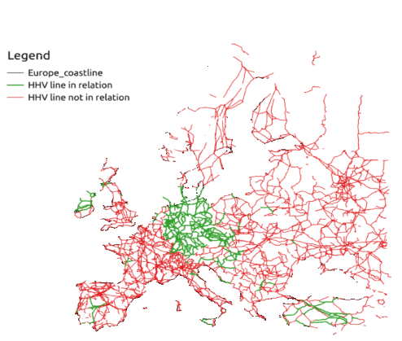
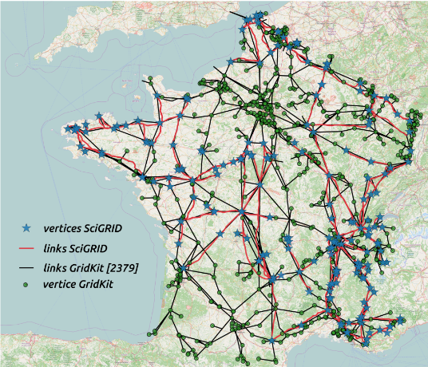
Previous project (electricity): SciGRID (Power) GridKit
B. Wiegmans, Masterarbeit: Improving the Topology of an Electric Network Model Based (2015)
OSM: Relations
OSM: Nodes & Ways

Slide 10
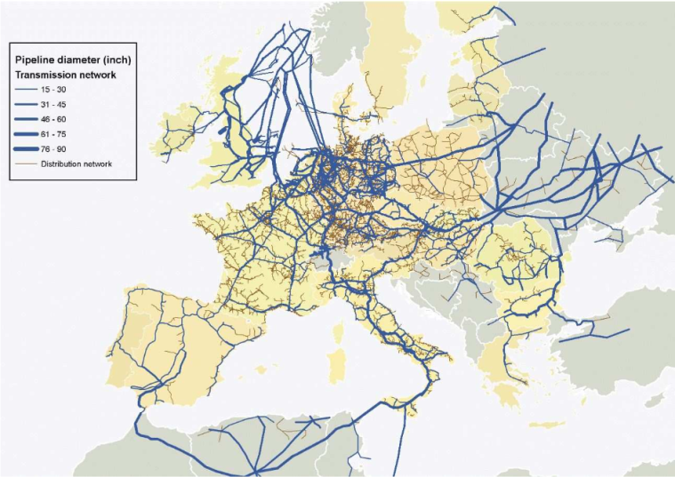
European gas transport network
Gas covering 25% of primary energy for Europe
Transport network ~120,000-200,000 km
Gas-sources:
North sea, central Asia,
Russia, Middle east,
Africa
16 LNG terminals
(Carvalho et al. 2009) “Robustness of Trans-European Gas Networks”

Slide 11
Modelling environment
Sparse data
Existing models and data only with restrictive copy/user right
Missing information on simplification and assumptions
Pipelines underground
Facility data commercially sensitive

Slide 12

Gas network model: SciGRID_gas
For scientists
Gas transport model data set
User expandable
Data model
Open source
Python
CC by
Open data
OSM data
Repeatable (GitHub)
Non-OSM data
For static gas- transport model
Heuristic
data generation
Europe wide

Slide 13
How to build an open gas transport data set?
Data Sources
- OSM
- GSE
- GIE
- LKD-eu
- EntsoG
- Wikipedia
- Press releases
Loading data from sources Many raw data sets
Converting into SciGRID_gas structures Many component data sets
Combining into single data set Single component data set
Generation of missing attributes Single filled component data set
Simplifying data set Single network data set 4 modelling
Single network data set

Slide 14

Homepage & Newsletter
www.gas.scigrid.de
news.gas-subscribe@scigrid.de

Slide 15
SciGRID_gas Definitions

Slide 16
How to build an open gas transport data set?
Data Sources
- OSM
- GSE
- GIE
- LKD-eu
- EntsoG
- Wikipedia
- Press releases
Loading data from sources Many raw data sets
Converting into SciGRID_gas structures Many component data sets
Combining into single data set Single component data set
Generation of missing attributes Single filled component data set
Simplifying data set Single network data set 4 modelling
Component data set
Network data set
Single network data set

Slide 17
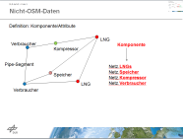
Gas network model
Definition: Component & Attribute
LNG
consumer
compressor
pipe-segment
storage
LNG
consumer

Slide 18
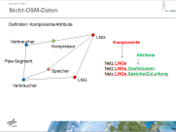
Gas network model: Components → Attributes
Component
consumer
LNG
compressor
Netz.LNGs
Netz.Storages
Netz.Compressor
Netz.Consumer
Netz.PipeSegment
pipe-segment
storage
LNG
consumer

Slide 19

Gas network model: Component → Attributes
Component
consumer
LNG
Attribute
compressor
Netz.LNGs
Netz.LNGs.id
Netz.LNGs.name
Netz.LNGs.node_id
Netz.LNGs.source_id
Netz.LNGs.lat
Netz.LNGs.long
Netz.LNGs.country_code
Netz.LNGs.comment
Netz.LNGs.param
Netz.LNGs.uncertainty
Netz.LNGs.method
pipe-segment
storage
LNG
consumer
Dictionaries

Slide 20
Gas network model: Component → Attributes
consumer
LNG
compressor
pipe-segment
storage
consumer
LNG
Netz.LNGs[0].name
Netz.LNGs[0].param[’max_cap_store2pipe_M_m3_per_d’]
Netz.LNGs[0].uncertainty[’max_cap_store2pipe_M_m3_per_d’]
Netz.LNGs[0].method[’max_cap_store2pipe_M_m3_per_d’]

Slide 21
Gas network model: Component → Attributes
Netz.LNGs[0].param:
{ 'end_year': None, 'license': None, 'max_cap_store2pipe_M_m3_per_d': 16.71232876712329, 'max_workingGas_M_m3': 110926712.0, 'source': 'http://www.gastrade.gr/en/the-company/the-project.aspx', 'start_year': 2022.0}
Netz.LNGs[0].method:
{'end_year': None, 'license': None, 'max_cap_store2pipe_M_m3_per_d': 'raw', 'max_workingGas_M_m3': 'raw', 'source': 'raw', 'start_year': 'raw'}
Netz.LNGs[0].uncertainty:
{'end_year': -999, 'license': -999, 'max_cap_store2pipe_M_m3_per_d': 0, 'max_workingGas_M_m3': 0, 'source': 0, 'start_year': 0}

Slide 22
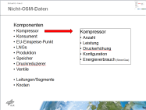
Gas network model: Components → Attributes
Components
BorderPoints
Compressors
ConnectionPoints
Consumers
EntryPoints
InterConnectionPoints
LNGs
Nodes
PipeLines
PipePoints
PipeSegments
Processes
Productions
Storages
(Pressure reducer)
(Valve)
Nodes
Edges

Slide 23

Gas network model : Fundamentals
Entry-Exit model
Supply demand model
SciGRID_gas
Number of nodes and pipelines
Static model
Dynamic model
complexity

Slide 24
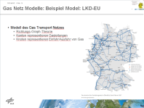
Gas network model : Data model
Data model e.g. LKD-EU

Slide 25
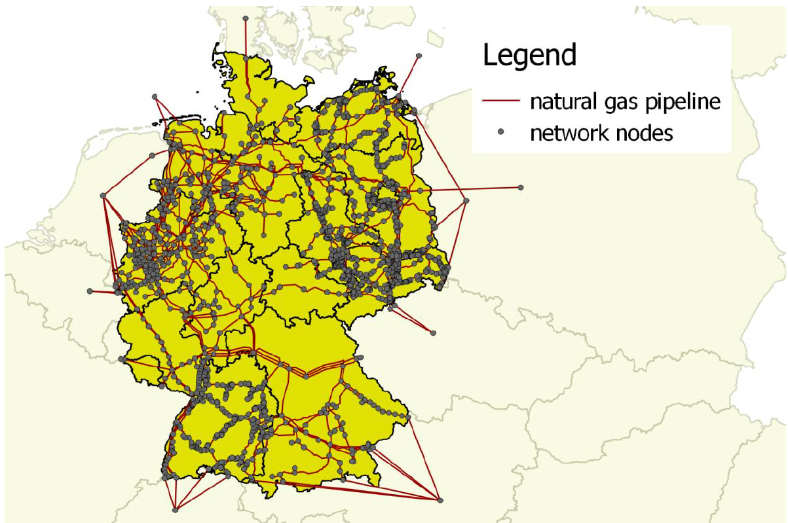
Gas network model : Example data set: LKD-EU
Data Documentation 92: Electricity, Heat and Gas Sector Data for Modelling the German system, Friedrich Kunz, et al.

Slide 26
Network model
Questions:
LNG
Verbraucher
Kompressor
Pipe-Segment
Speicher
LNG
Verbraucher

Slide 27
OpenStreetMap data in

Slide 28
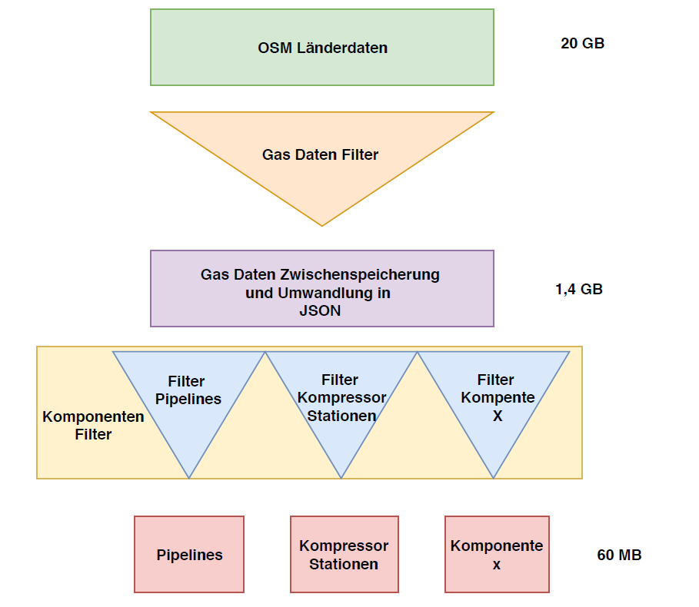
Processing of OSM data in SciGRID_gas

Slide 29
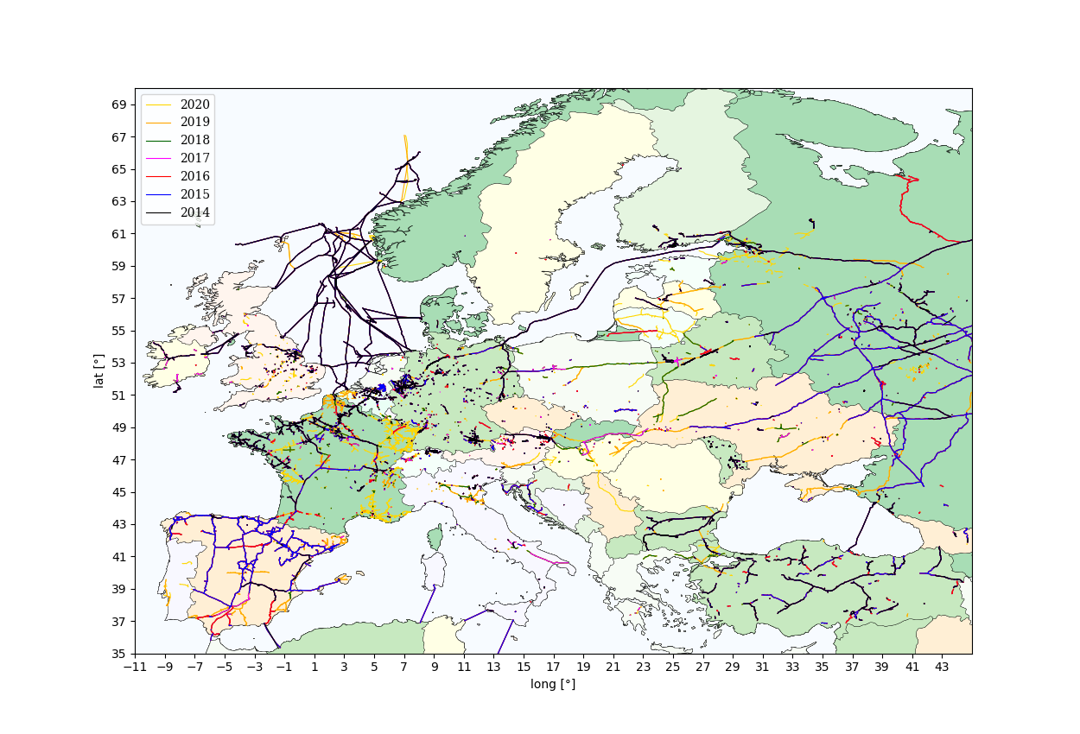
Pipelines ways in OSM

Slide 30
Non-OSM Data

Slide 31

Non-OSM data
Few samples
Topologically inaccurate/ accurate
Powerful:
Gas pipeline diameter
Gas pressure
Storage volume
Gas power plant
Compressor (number of turbines/power)
Time series:
Gas flow
Storage
LNG
Production
Consumers
POWERFUL
but
SPARSE

Slide 32
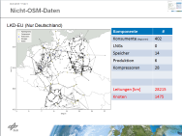
Non-OSM data
EntsoG (Gas TSOs)
GIE (Gas Infrastructure Euro: LNG, storage) GSE (Gas Storage Euro: storage)
GB (govt)
LKD-EU (DWI)
Internet data (further data)
OPSD (Open Power System Data)
FNB (Fernleitungs Netz Betreib)
GasLib (Unis & OpenGridEurope)

Slide 33
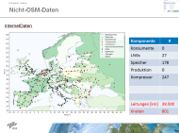
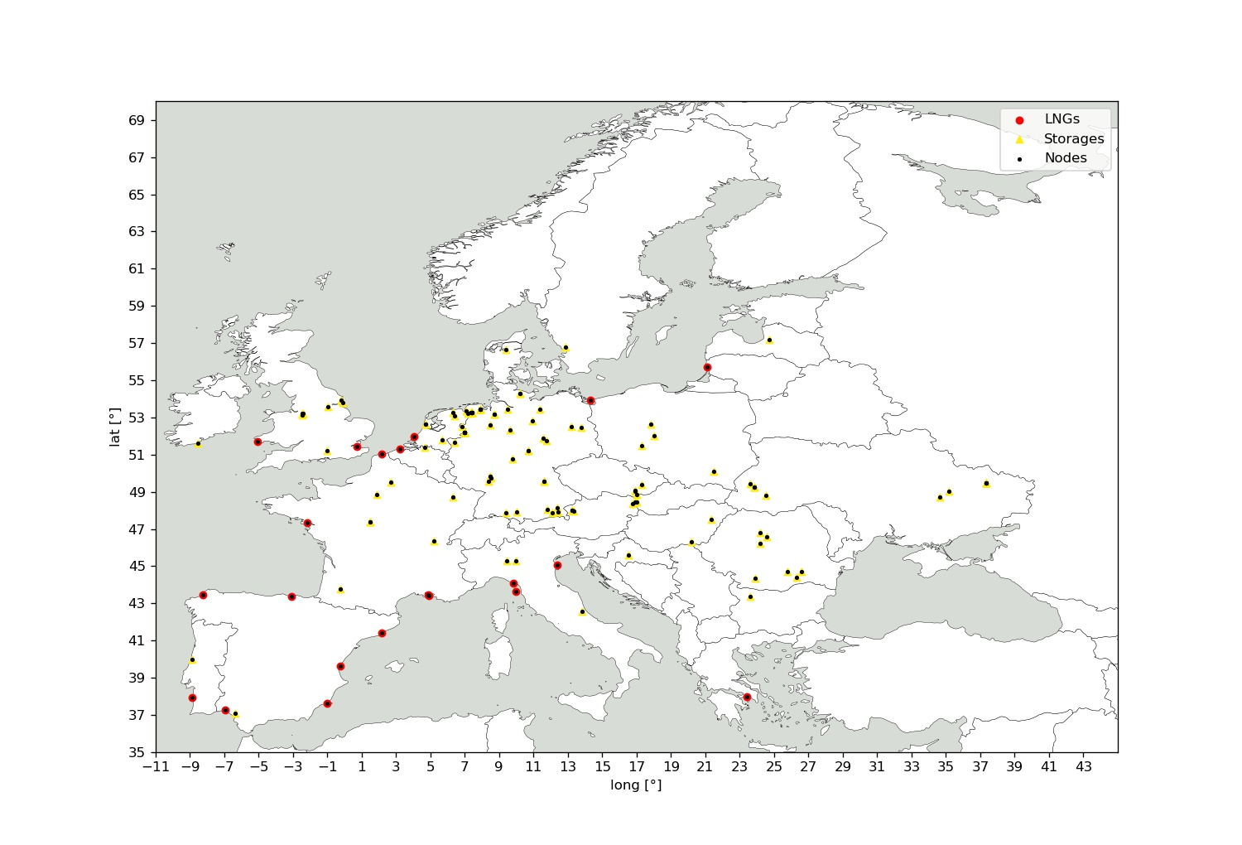
Non-OSM data
GIE
Component | #
Consumers | 0
LNGs | 21
Storages | 99
Production | 0
Compressors | 0
Pipelines | 0
Nodes | 98
https://agsi.gie.eu and https://alsi.gie.eu

Slide 34
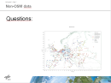
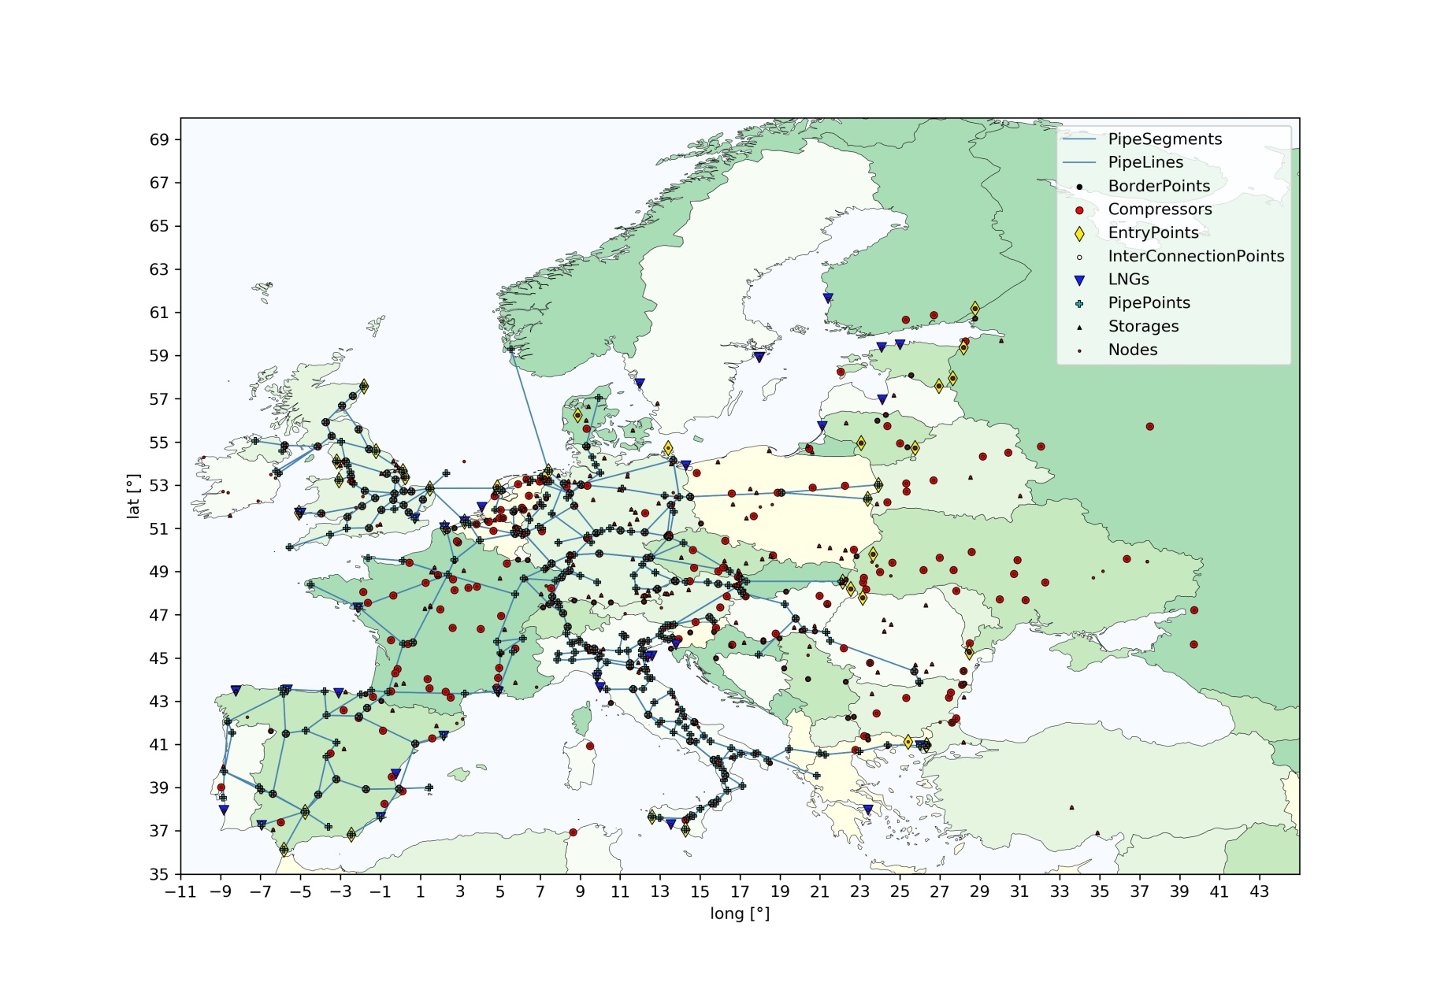
Non-OSM data
InternetData
Component | #
Consumers | 0
LNGs | 32
Storages | 197
Productions | 0
Compressors | 237
Pipelines [km] | 46.336
Nodes | 739
Source: various

Slide 35
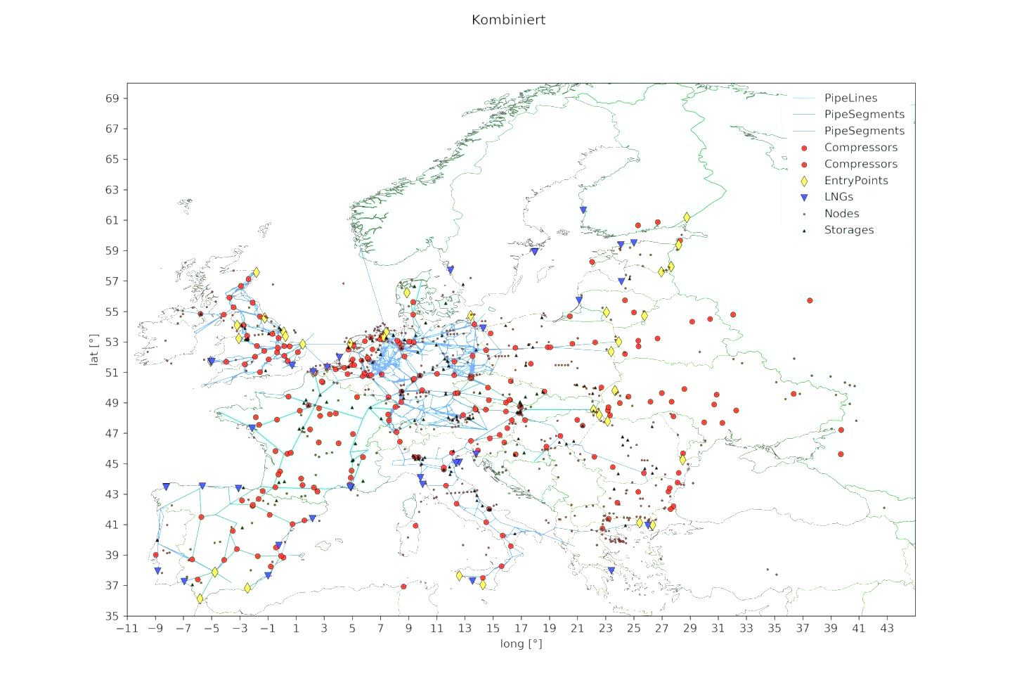
Non-OSM data
Questions:

Slide 36
Heuristic – (Teaser)

Slide 37
How to build an open gas transport data set?
Data Sources
- OSM
- GSE
- GIE
- LKD-eu
- EntsoG
- Wikipedia
- Press releases
Loading data from sources Many raw data sets
Converting into SciGRID_gas structures Many component data sets
Combining into single data set Single component data set
Generation of missing attributes Single filled component data set
Simplifying data set Single network data set 4 modelling
Single network data set

Slide 38
Heuristic
Joining nodes through attribute names
Joining nodes through relative distance

Slide 39
Heuristic
Attribute generation
Comp. power
Compressor
Pipe thickness

Slide 40
Heuristic
Future:
OSM pipelines/pipe-segments joining:
distance
attribute

Slide 41
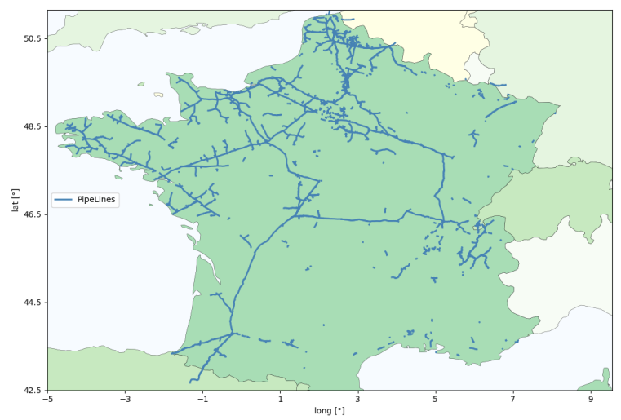
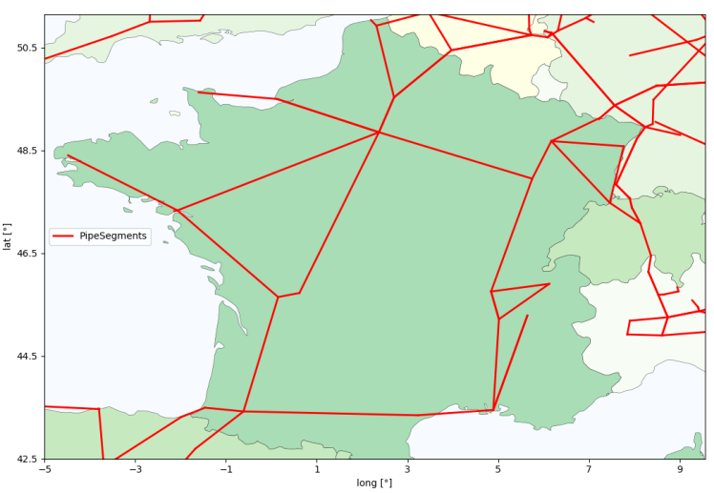
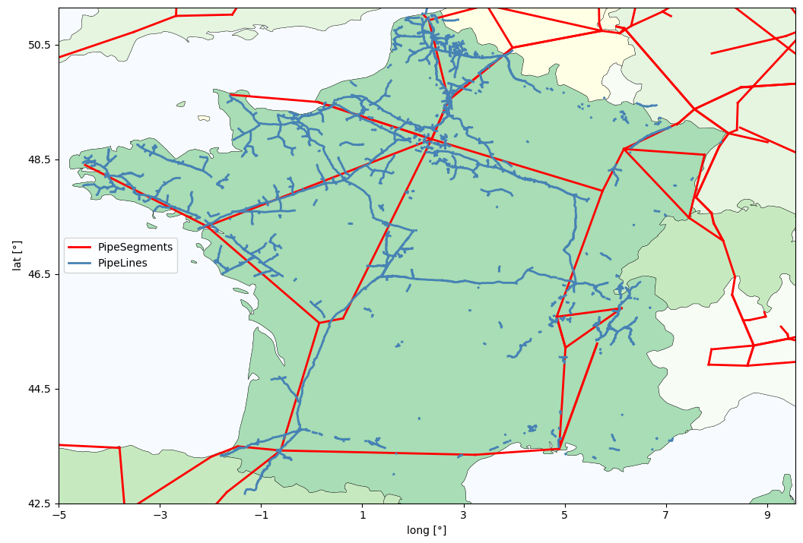
Heuristic
OSM Non-OSM
Goal:
Joining of:
Components
Attributes

Slide 42
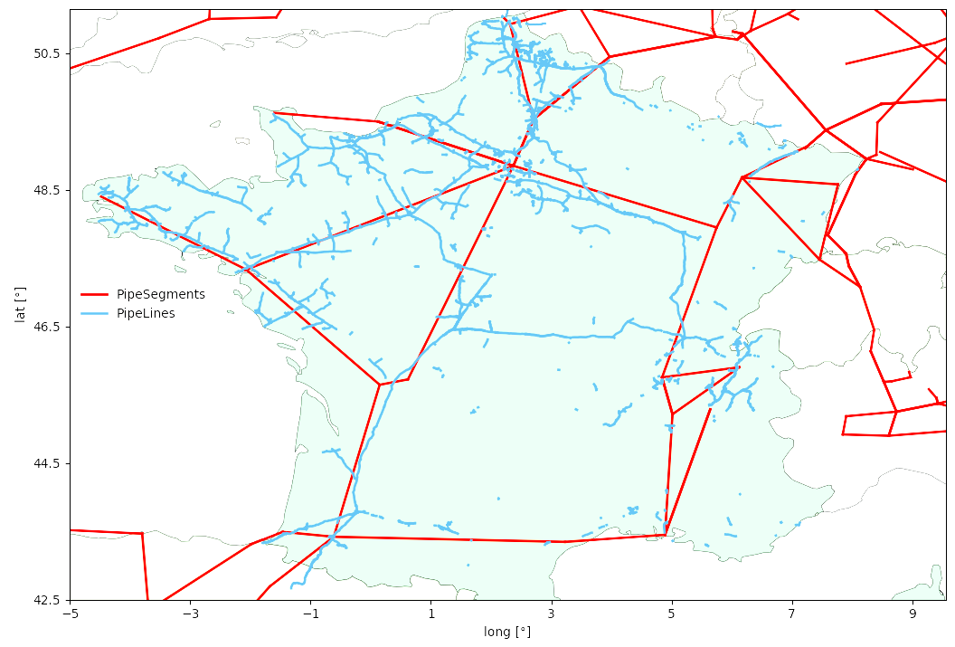
Heuristic
Questions:

Slide 43
Hands On: Pathway

Slide 44
Hands on: Pathway
Joining
Filling values
Simplifying network
OSM
Internet
Individual data sets
GIE
Net rk s
NET W O RK S
Network
EntsoG
LKD-EU

Slide 45
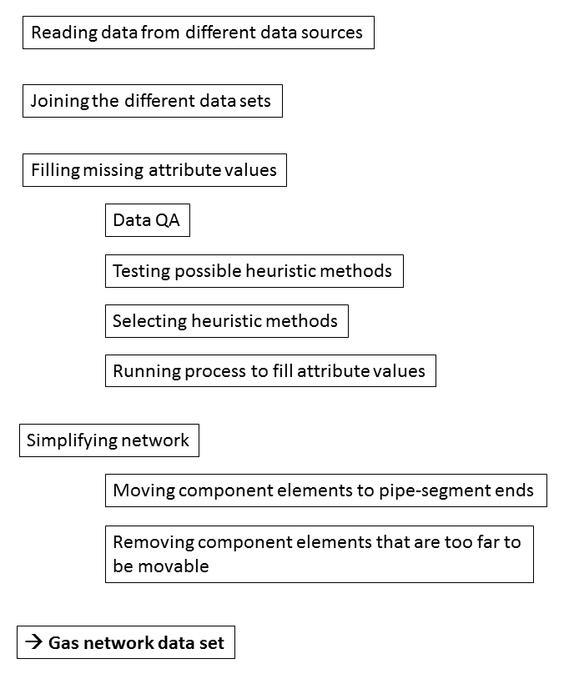
Hands on: Detailed pathway

Slide 46
Hands on: Additional tools
Additional tools:
SciGRID_gas data input/output
SciGRID_gas data visualization

Slide 47
Hands on: Start
Steps:
Open Anaconda prompt
Navigate to main OpenSciGRID_gas folder
Execute “jupyter notebook”
In FF browser select “Gen_02_NonOSM.ipynb”
OR
Gen_02_NonOSM.py

Slide 48
Hands On: Functions

Slide 49
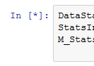

Hands on: Functions
Execution of Jupyter Notebook commands

Slide 50
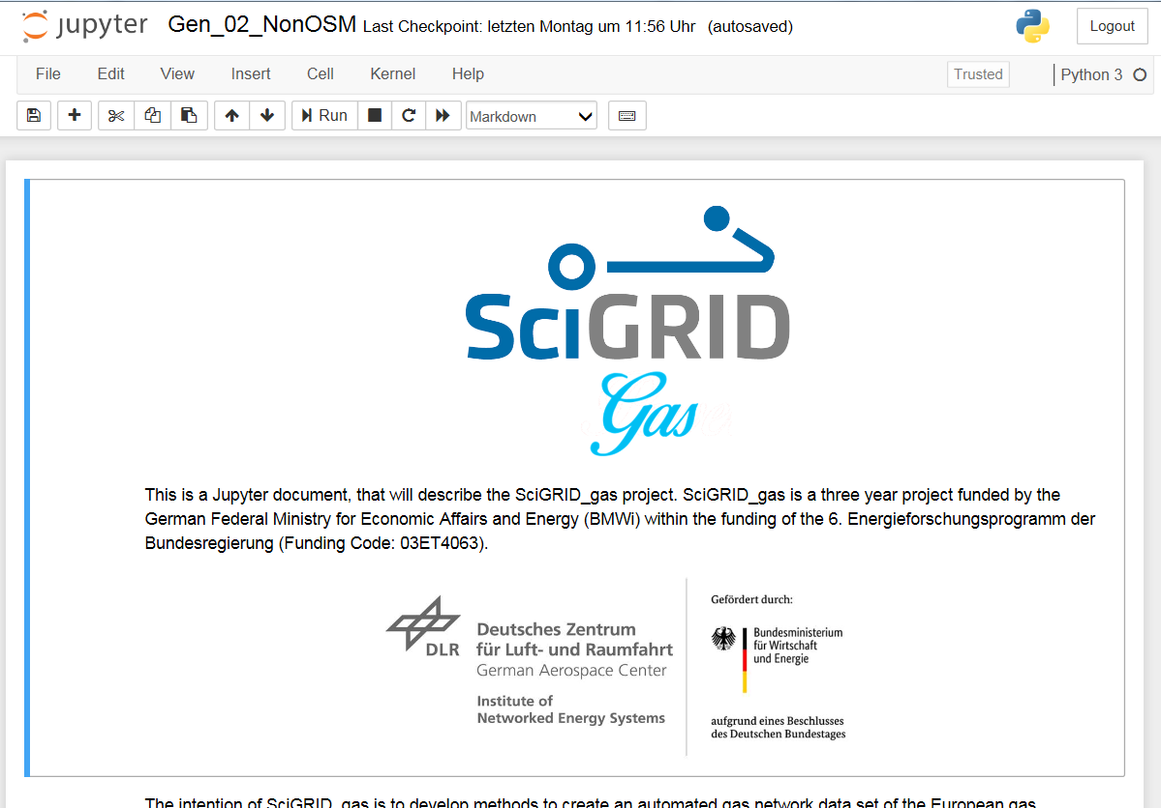
Hands on: Functions

Slide 51
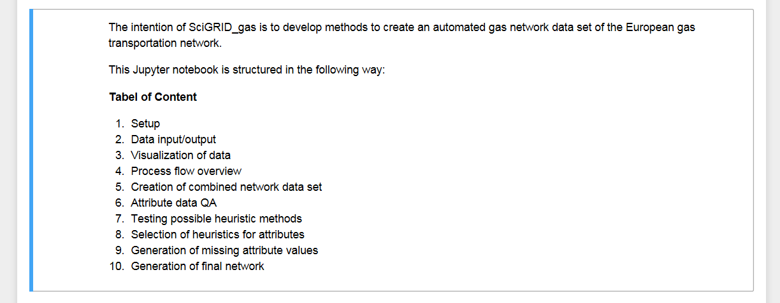
Hands on:

Slide 52
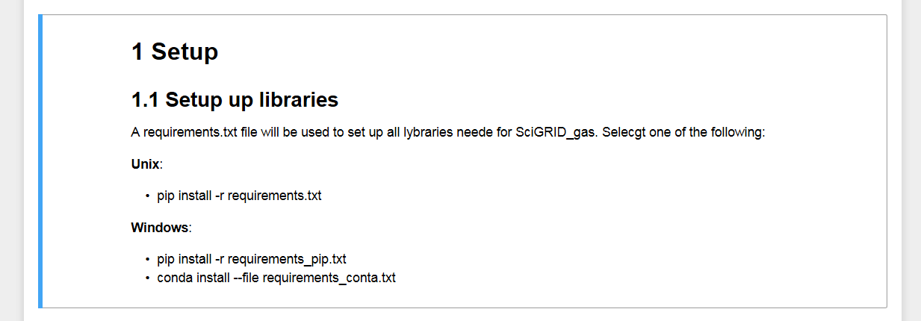
Hands on: Pip install

Slide 53
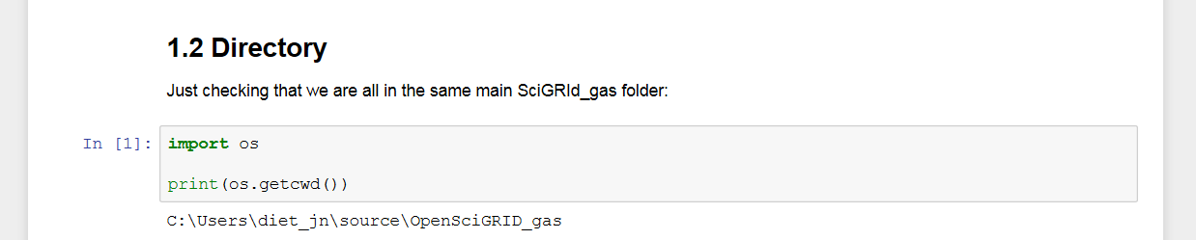
Hands on: Directory

Slide 54
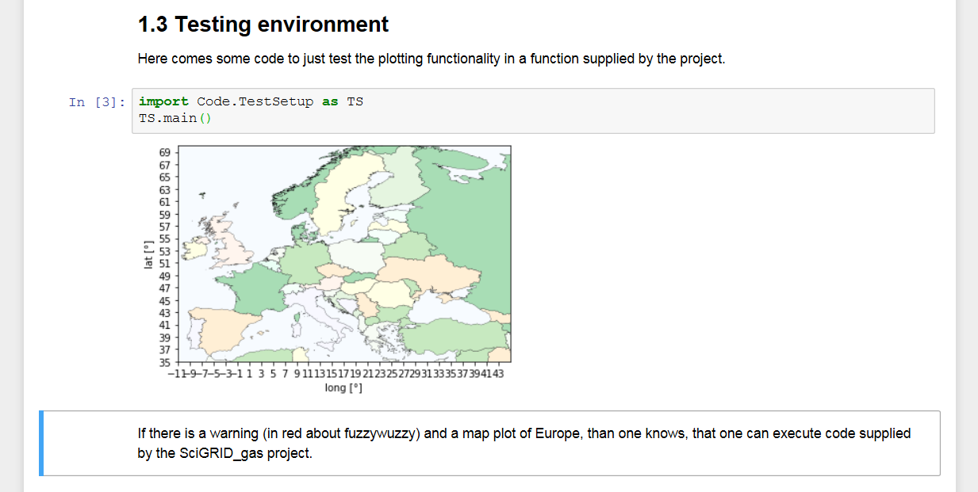
Hands on: Test

Slide 55
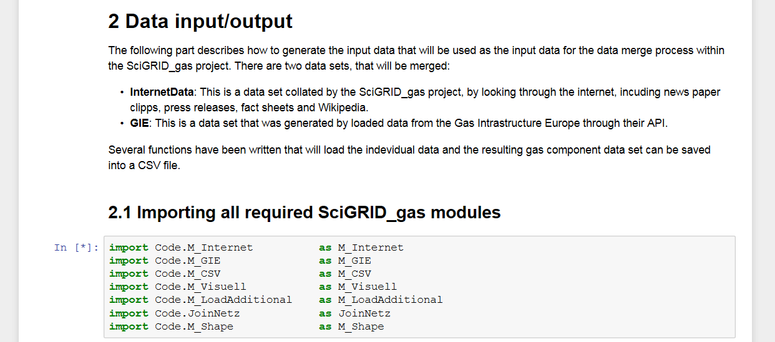
Hands on: M_InterNet

Slide 56
Hands on: M_InterNet

Slide 57
Hands on: M_InterNet
2.2 Data Input/output
Netz_Internet = M_Internet.read()
NumDataSets: (Optional = 100000) number of data sets
requeYear: (Optional = '2010') string containing year [####] for which data is to be retrieved
licenseType: (Optional= ''), string containing the kind of license that the data will be selected on
GasType: (Optional = 'H') a character indicating either H or L gas.
Netz_GIE = M_GIE.read()

Slide 58
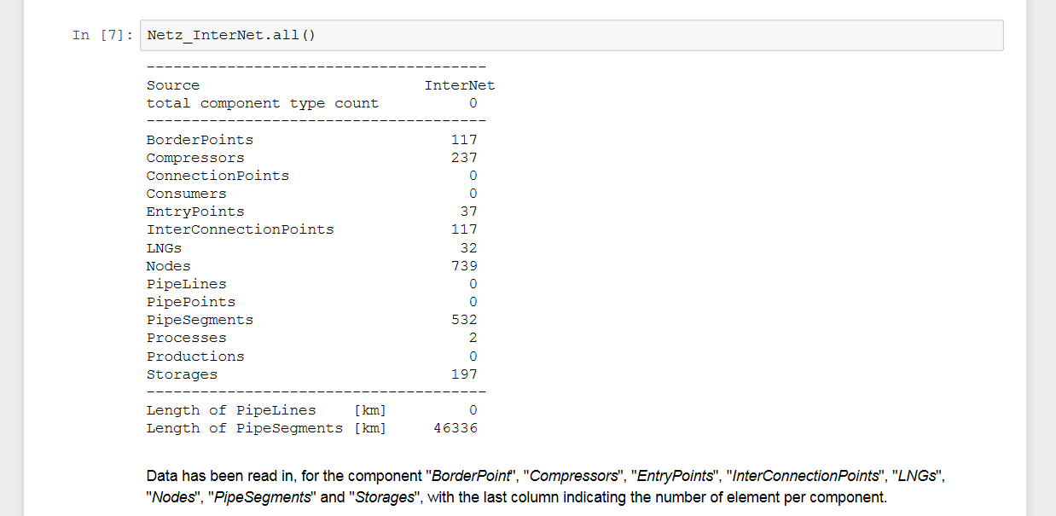
Hands on: .all()

Slide 59
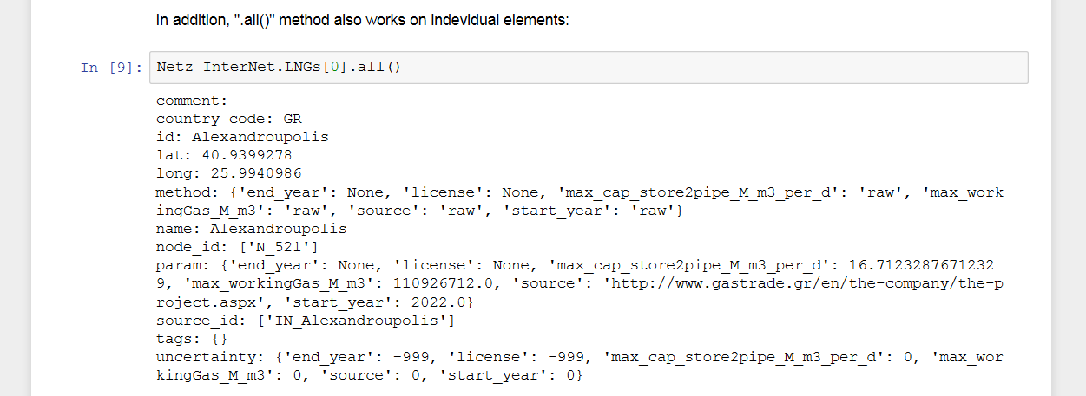
Hands on: .all()

Slide 60
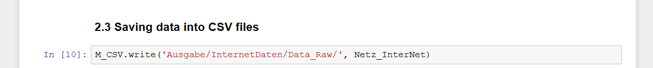
Hands on: M_CSV.write()

Slide 61
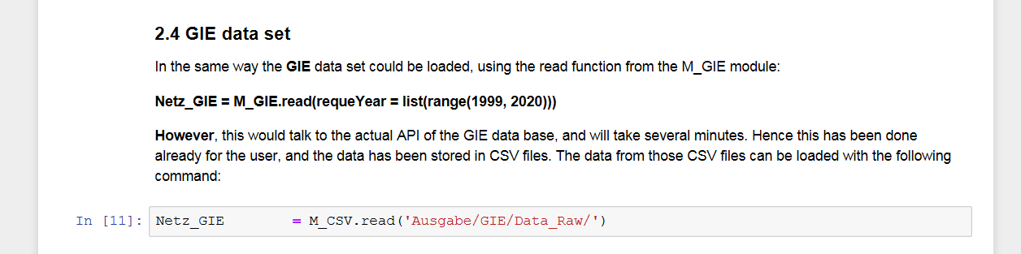
Hands on: M_CSV.read()

Slide 62
Hands on: M_CSV.read()
Netz_GIE = M_CSV.read('Ausgabe/GIE/Data_Raw/')
RelDirName String containing path name of data location [default: 'Eingabe/CSV/']
NumDataSets Number of elements to be read for each component [default: 1e+100]

Slide 63
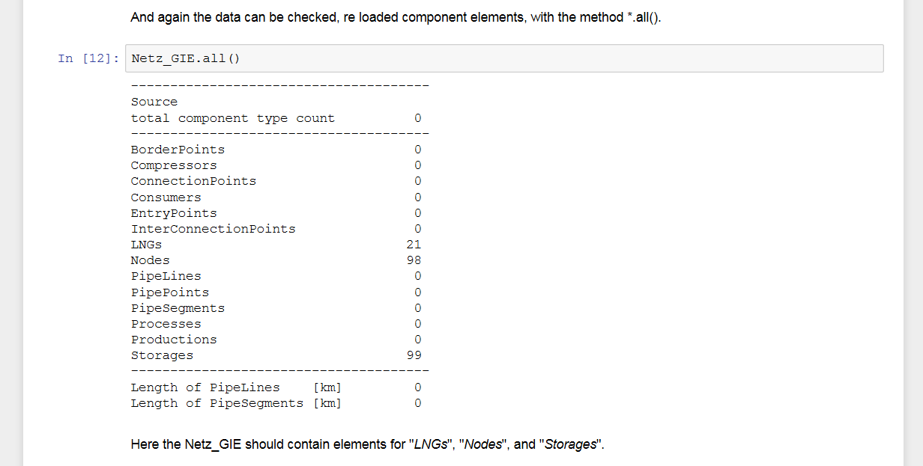
Hands on: .all()

Slide 64
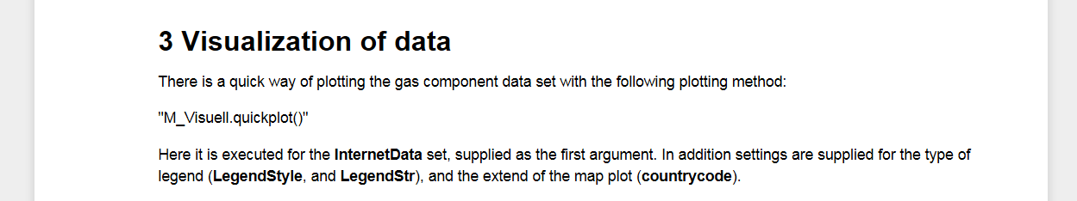
Hands on: M_Visuell.quickplot()

Slide 65
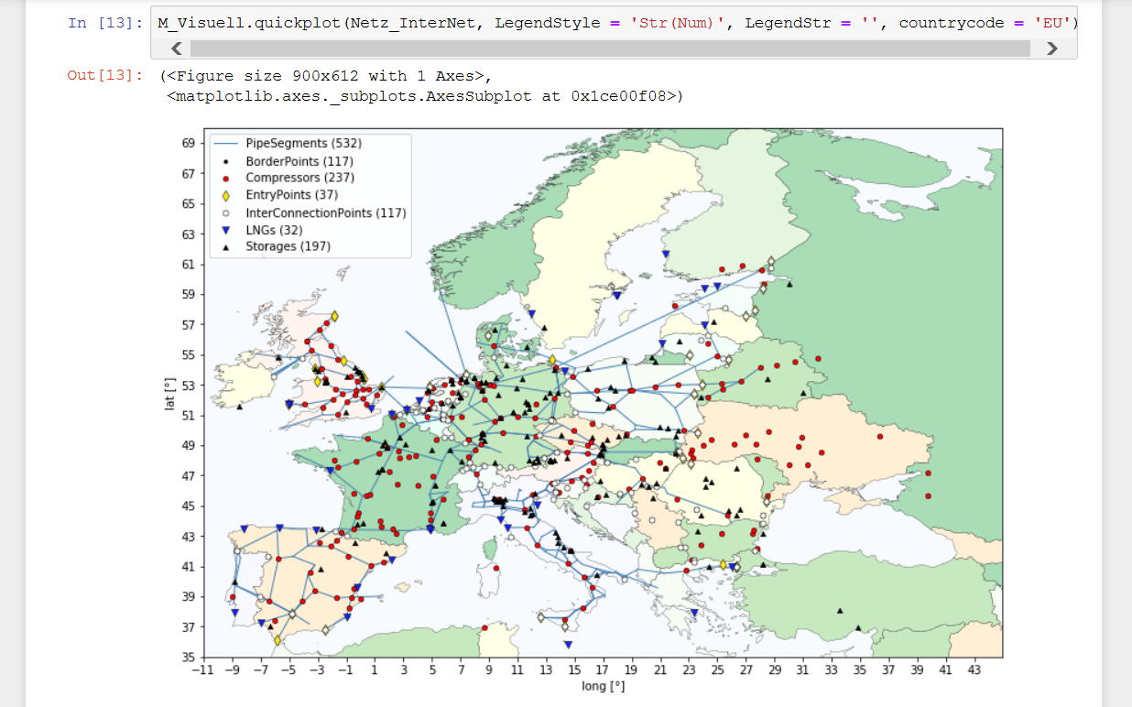
Hands on: M_Visuell.quickplot()

Slide 66
Hands on: M_Visuell.quickplot()
M_Visuell.quickplot(Netz, LegendStyle = 'Str(Num)', LegendStr = '', countrycode = 'EU')
Netz An Instance of the network class
SingleColor Str , same as in Matplotlib [default: '']
SingleMarker Str , same as in Matplotlib [default: '']
Cursor Boolean, if true you can get details on mouse-click [default: False]
savefile Str, namepath [default: '']
PlotList List of plotable NetClass.Elements (e.g. Nodes, Pipelines)
IgnoreList List of ignorable NetClass.Elements (e.g. Nodes, PipeLines) [default: ['PipePoints', 'GasFlowData', 'Processes', 'Nodes', 'SourceName']
countrycode Str of 2-digit country-code - will be used for the basemap [default: 'EU']
figureNum Int, number of the figure [default: 1]
Save Boolean, to save the plot [default: False]
LegendStyle Plots name of component without number of elements ('Str') or with number of elements ('Str(Num)') [default: 'Str']

Slide 67
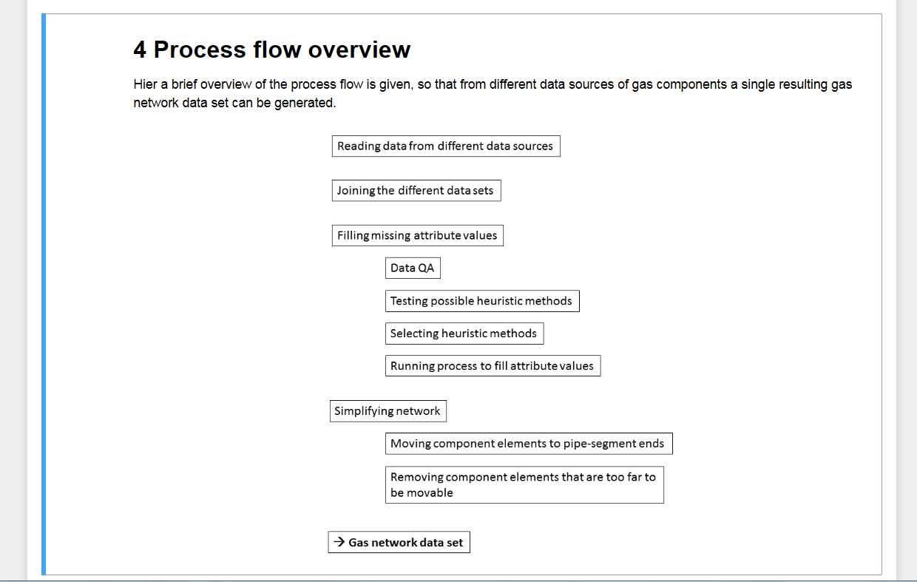
Hands on: ProcessFlow

Slide 68
How to build an open gas transport data set?
4 Process flow overview
Data Sources
- OSM
- GSE
- GIE
- LKD-eu
- EntsoG
- Wikipedia
- Press releases
Loading data from sources Many raw data sets
Converting into SciGRID_gas structures Many component data sets
Combining into single data set Single component data set
Generation of missing attributes Single filled component data set
Simplifying data set Single network data set 4 modelling
Single network data set

Slide 69
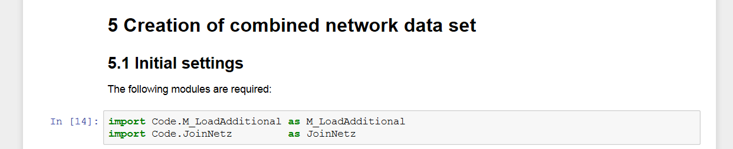
Hands on: Combining data sets

Slide 70
How to build an open gas transport data set?
Process flow overview
Data Sources
- OSM
- GSE
- GIE
- LKD-eu
- EntsoG
- Wikipedia
- Press releases
Loading data from sources Many raw data sets
Converting into SciGRID_gas structures Many component data sets
Combining into single data set Single component data set
Generation of missing attributes Single filled component data set
Simplifying data set Single network data set 4 modelling
Single network data set

Slide 71
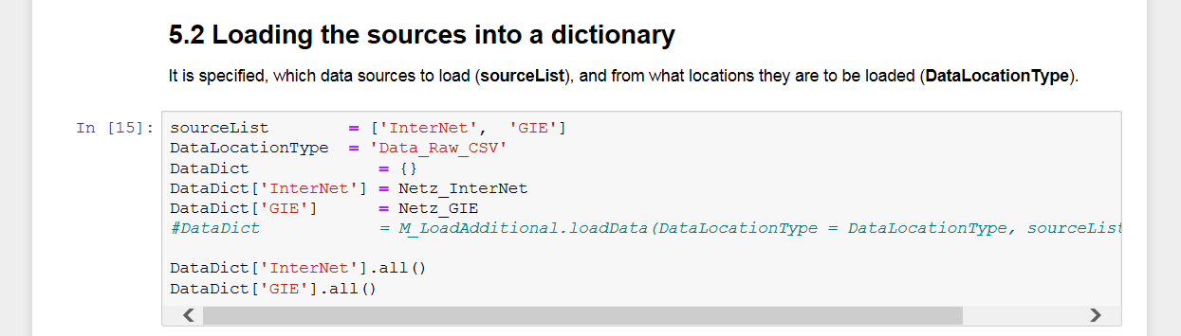
Hands on: Forming a dict

Slide 72
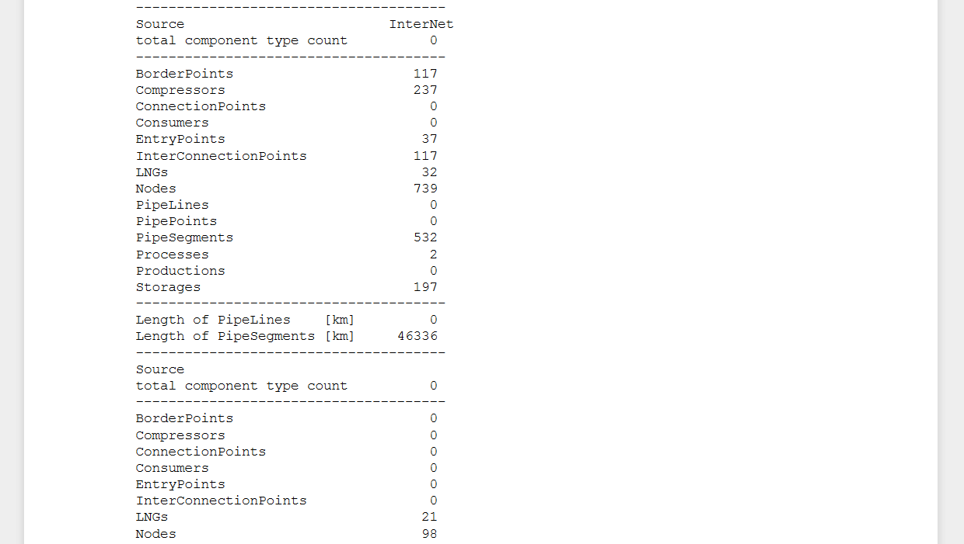
Hands on:

Slide 73
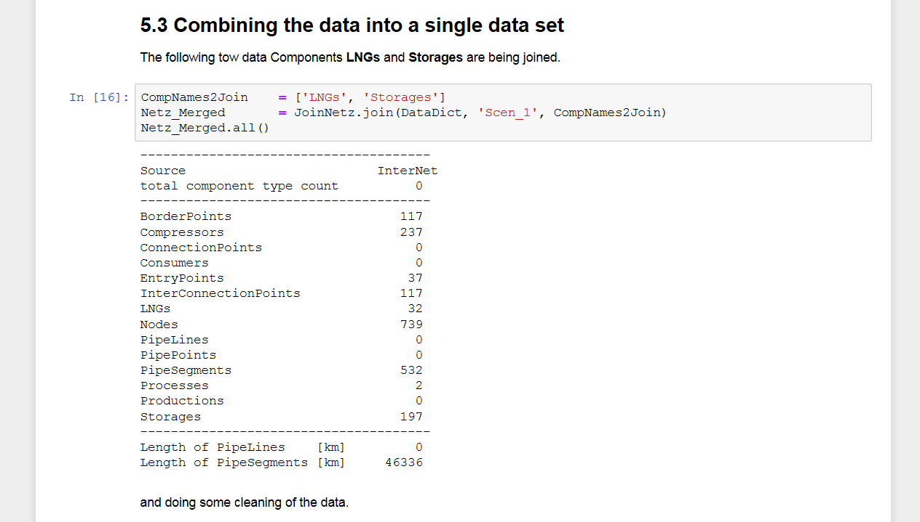
Hands on: JoinNetz.join()

Slide 74
Hands on: JoinNetz.join
Netz_Merged = JoinNetz.join(DataDict , scenaName = 'Scen_1', CompNames2Join = ['LNGs', 'Storages'])
DataDict Python dictionary of network class instances
scenaName String of scenario name selected on how to join data sets Currently the only option implemented [default: 'Scen_1']
CompNames List of component string names to join [default: []]

Slide 75
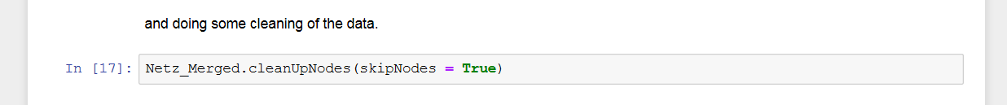
Hands on: .cleanUpNodes()

Slide 76
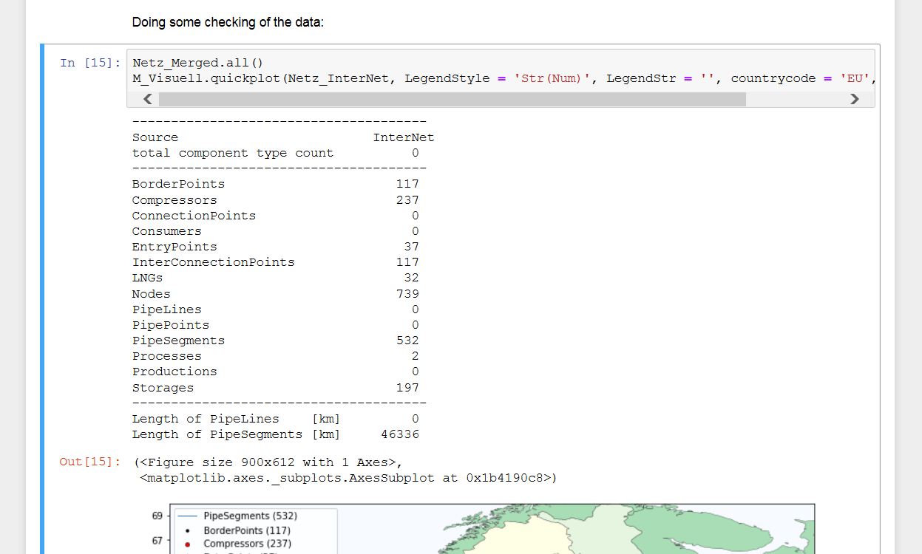
Hands on:

Slide 77
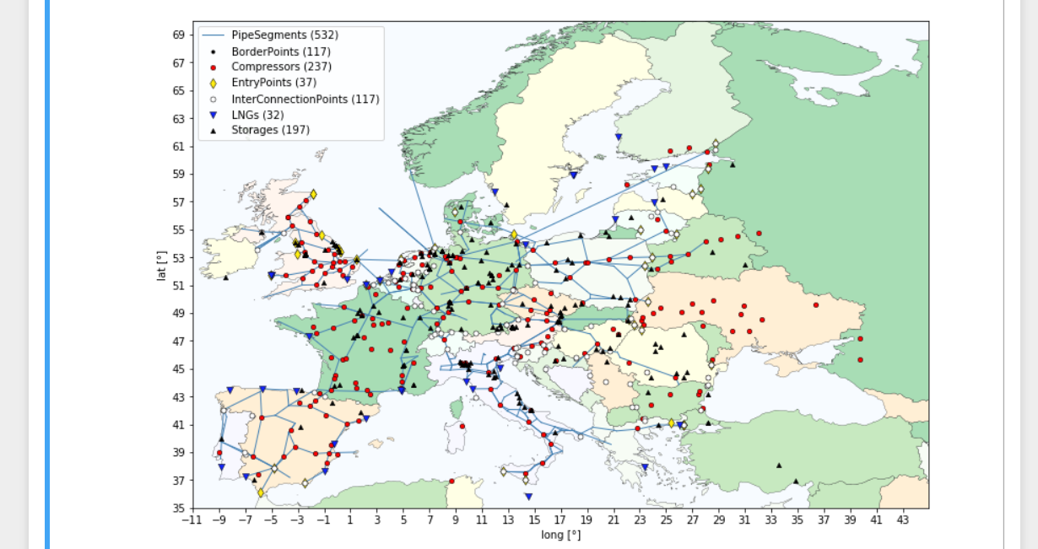
Hands on:

Slide 78
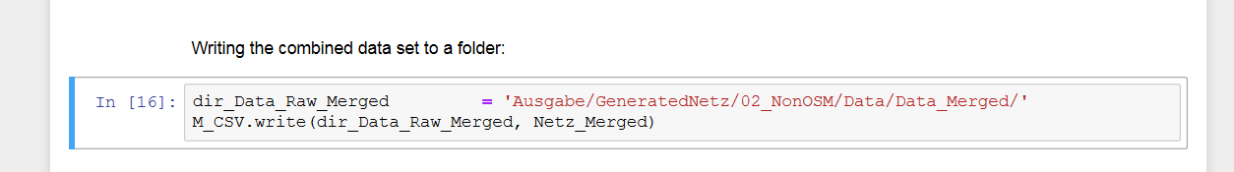
Hands on: Saving data

Slide 79
How to build an open gas transport data set?
4 Process flow overview
Data Sources
- OSM
- GSE
- GIE
- LKD-eu
- EntsoG
- Wikipedia
- Press releases
Loading data from sources Many raw data sets
Converting into SciGRID_gas structures Many component data sets
Combining into single data set Single component data set
Generation of missing attributes Single filled component data set
Simplifying data set Single network data set 4 modelling
Single network data set

Slide 80
Hands on: Detailed pathway

Slide 81

Hands on: Plotting Histograms

Slide 82

Hands on: Setup Files

Slide 83

Hands on:

Slide 84

Hands on: M_Stats.gen_DataHists

Slide 85
Hands on: M_Stats.gen_DataHists
6.2 Attribute data QA
M_Stats.gen_DataHists(Netz_Merged, StatsInputDirName = StatsInputDirName, DataStatsOutput = DataStatsOutput,)
Netz Instance of a network class
CompNames List of strings of components to apply this function to [default: []]
AttribNames List of strings of attributes to apply this function to [default: []]
StatsInputDirName String of relative path location of input setup files [default: 'Eingabe/Input_Settings']
DataStatsOutput String of relative path where to put plots [default: 'Ausgabe/Heuristic/StatsData']

Slide 86

Hands on: M_Stats.gen_DataHists

Slide 87

Hands on: M_Stats.gen_DataHists

Slide 88

Hands on: Testing heuristics

Slide 89




Hands on: Background
Dependent variable (D)
Feature variable (Fn)
D = Mn(Fn)
D = Mn(F0, F1)
D = Mn(F0, F1, F2)
Methods (Mn)
Linear (Lasso) Logistic Median Mean
Min
Max

Slide 90


Hands on: Background
A = Linear, B
A = Linear, C
A = Linear, D
A = Linear, B, C
A = Linear, B, D
A = Linear, C, D
A = Linear, B, C, D
A = Median, A
A = Mean, A
A = Min, A
A = Max, A
B = Linear, A
B = Linear, C
B = Linear, D
B = Linear, A, C
B = Linear, A, D
B = Linear, C, D
B = Linear, A, C, D
B = Median, B
B = Mean, B
B = Min, B
B = Max, B
C = Linear, A
C = Linear, B
C = Linear, D
C = Linear, A, B
C = Linear, A, D
C = Linear, B, D
C = Linear, A, B, D
C = Median, C
C = Mean, C
C = Min, C
C = Max, C
A
B
C
D
.., and many more, and which one to use??

Slide 91
Hands on: Detailed pathway
Setup up input files
Testing of method & feature combinations
User selects method & feature combination
Process of estimating attribute values

Slide 92

Hands on: Setup Files

Slide 93

Hands on: Setup files

Slide 94

Hands on: M_Stats.get_StatsParam()

Slide 95
Hands on: M_Stats.get_StatsParam
7.2 Execution
M_Stats.gen_StatsParam(Netz_Merged, CompNames = CompNames2Test, SavePlots = True, MaxCombDepth = 1, StatsInputDirName = 'Ausgabe/GeneratedNetz/02_NonOSM/SetupFiles',
DataStatsOutput = 'Ausgabe/GeneratedNetz/02_NonOSM/StatsData')
Netz Instance of the network class
CompNames List of component name strings to carry out process [default : [] = will do all]
AttribNames List of attribute labels to carry out process [default : [] = will do all]
StatsInputDirName String of relative path where setup files can be found [default: 'Eingabe/Input_Settings']
DataStatsOutput String of relative path where to put output CSV files [default: 'Ausgabe/Heuristic/StatsData']
MaxCombDepth Int, of depth feature permutations [default: 2]

Slide 96
Hands on: Hands on
8 Selection of heuristics for attributes
.. /Ausgabe/GeneratedNetz/02_NonOSM/StatsData/
RetSummary_Compressors.csv
RetSummary_LNGs.csv
RetSummary_PipeSegments.csv
RetSummary_Storages.csv

Slide 97

Hands on: Hands on

Slide 98



Hands on: Hands on

Slide 99

Hands on: M_Stats.pop_Attribs()

Slide 100
Hands on: M_Stats.pop_Attribs
9 Generation of missing attribute values
Netz_Merged = M_Stats.pop_Attribs(Netz_Merged, CompNames = [compName], SimSettings = SimSettings)
Netz Instance of network class
CompNames List of component strings to be carried out [default: []]
SimSettings List of settings [default: []]

Slide 101

Hands on: .make_Attrib()

Slide 102
Hands on: .make_Attrib()
Netz_Component.make_Attrib([], '', 'end_year', 'const', 2050)
CompName List of Strings of names of Component name [default =[]]
AttribNameSource String of attribute name of component where the data come from (source)
AttribNameDestination String of attribute name, into which new values will be written into.
MethodName String of method used to generate the new attribute value. Currently implemented options:
‘median’
'mean'
'min'
'max'
'const‘
[default: ‘median’]
MethodVal String or value to be used for the 'const' MethodName method.
ReplaceType String indicating to fill missing ('fill') or replace all ('replace') attribute values [default: 'fill']

Slide 103

Hands on:

Slide 104
How to build an open gas transport data set?
10 Generation of final network
Data Sources
- OSM
- GSE
- GIE
- LKD-eu
- EntsoG
- Wikipedia
- Press releases
Loading data from sources Many raw data sets
Converting into SciGRID_gas structures Many component data sets
Combining into single data set Single component data set
Generation of missing attributes Single filled component data set
Simplifying data set Single network data set 4 modelling
Single network data set

Slide 105

Hands on: M_Shape.moveComp2Pipe

Slide 106

Hands on: M_Shape.moveComp2Pipe
Netz_Final = M_Shape.moveComp2Pipe(Netz_Component.copy2(), 'Compressors', 'PipeSegments', maxDistance = 100.0)
Netz Instance of network class, best to be supplied as copy
compName String of component name
pipeName String, 'PipeLines' or 'PipeSegments'
maxDistance Integer of maximum moved distance for each element [default: 2]

Slide 107

Hands on: Further commands
Netz_Final.remove_unConnectedComponents()
Netz_Final.remove_unUsedNodes()

Slide 108

Hands on: Final

Slide 109

Hands on: The End

Slide 110
Hands on: Questions
For scientists
Gas transport model data set
User expandable
Data model
Python
Open source
Open data
CC by
OSM data
Repeatable (GitHub)
Non-OSM data
For static gas- transport model
Heuristic
data generation
Europe wide

